Slide 1
What links unemployment and the state budget deficit?
By Pierce, Emily, and Katie

Slide 2
What’s going on?
The state's anticipated revenues have fallen well short of its anticipated expenditures over the coming year
Solution…
Balance down → reduced expenditures, indirectly or directly
Balance up → increased revenues through taxes

Slide 3
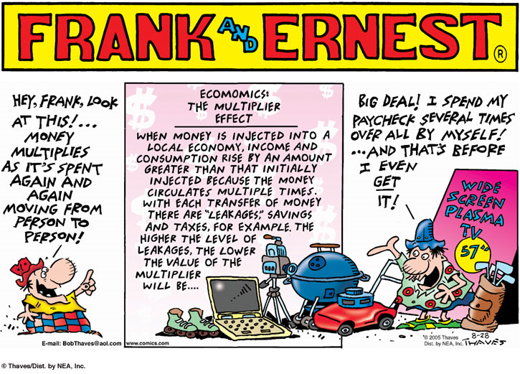

Slide 4
1. Does Frank understand the "multiplier effect"?
No
Pipeline analogy
Multiplier effected weakened

Slide 5
How does the typical explanation of "leakages" have to be amended to handle Frank's case?
Expanded definition
Living outside his means
Withholding money from circulation
Spending with credit

Slide 6
2. If the state government balances down through "cutting fraud and waste", will that still lead to reduced employment?
Fraud
When information is misrepresented, concealed, or omitted for personal gain/benefit.
Ex.→ Gov. Spending Excess $
Waste
Unnecessary spending
Employees from gov’t waste

Slide 7
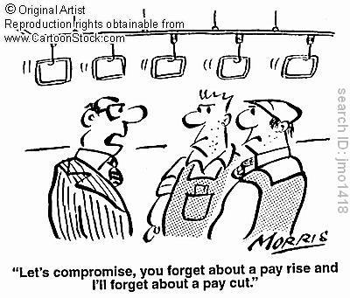
3. Which type of expenditure is more likely to support a North Carolina job: state government or private citizen?
http://abclocal.go.com/wtvd/story?section=news/local&id=6784337
State government
Wage cuts vs. massive lay-offs

